Slide 1


Slide 2
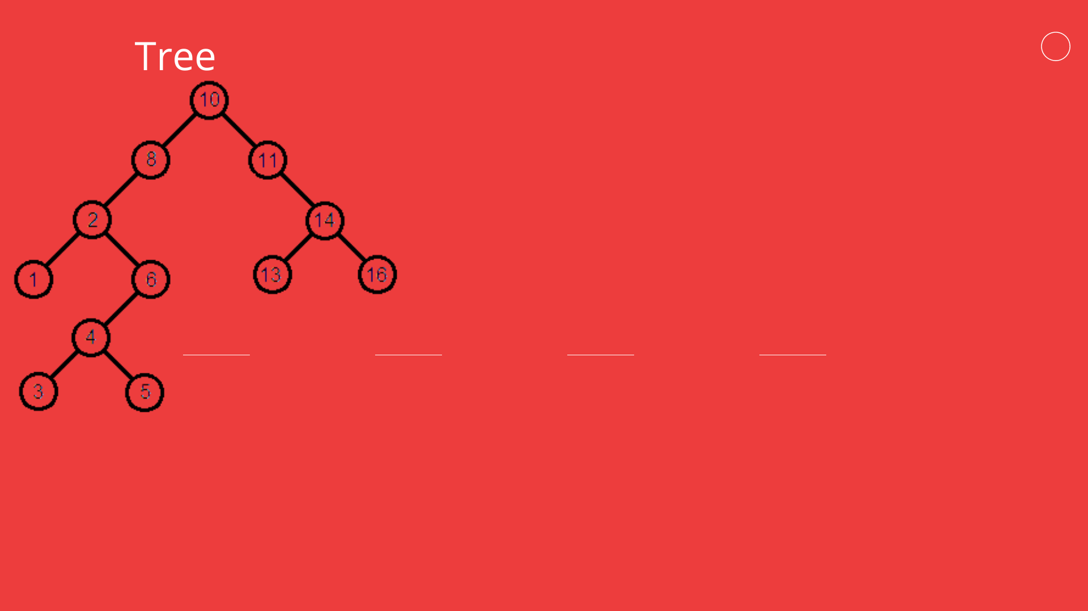
Algorithm
bst(root, l, r,k)
1. loc:= bst(r, k, NULL)
2. If loc = NULL then Print: “Item not found”.
3. Else Print: “Item found in bst”.
4. End.
A
B
C
D
E
H
F
G
I
J
Here
root=root of bst
r=right leaf
l=left leaf
k=key
K
L
Searching for 2

Slide 3

Search(Node,Key)
1. If Node = NULL then return NULL.
2. If Key < Node.Key then Search(Node.Left, Key).
3. Else if Key > Node.Key then Search(Node.Right, Key
4. Else return Node
Steps:
Search(Root, 2) Search(A,2)
Search(A->Left,2) Search(B, 2)
Search(B->Left, 2) Search(D, 2)
Return D and Print: Item found in BST.
Explanation
First compare the element with the parent leaf if found the return else compare if the
searching element is less then parent node then go the left node else right node so we
done this process and finally found the element in leaf D.

Slide 4
Thank you

